Slide 1

Ames Housing Price Prediction
Sean Godfrey | Sai Prabhu Kalva | Fernando Salazar | Katrina Li | Ben Wilson
Team 5
CHARLOTTESVILLE, VA
WASHINGTON, DC
SAN FRANCISCO, CA
SHANGHAI, CHINA

Slide 2
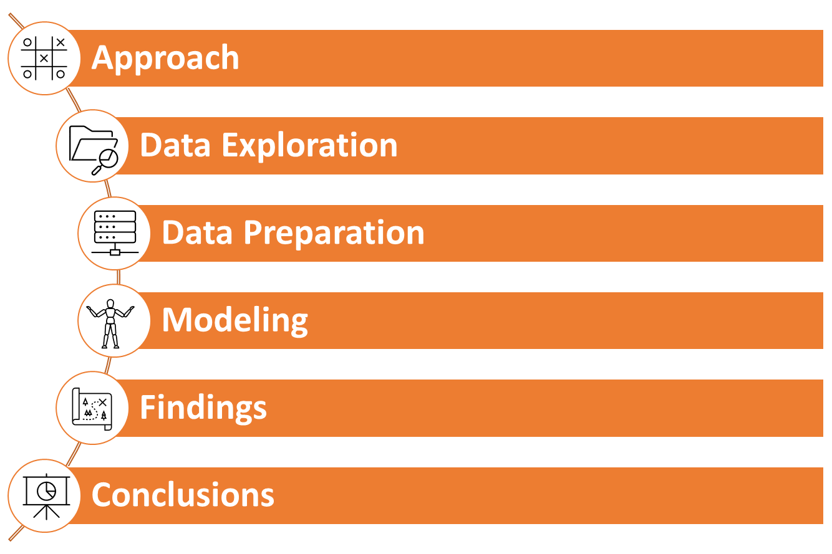
Table of contents
00 | introduction

Slide 3

Zillow home buying program prior issues
00 | introduction
Zillow failed to accurately predict price changes with its algorithmic approach
Zillow lost about $25K on each sell
Our project aims to develop a model that will more accurately reflect house prices

Slide 4
01
approach

Slide 5

CRISP-DM
01 | Approach
Business Understanding
Data Understanding
Data Preparation
Modeling
Evaluation
Data

Slide 6
02
Exploratory data analysis

Slide 7
House price distribution
02 | eda
Plot
Description
The number of sold peak at prices $80k-$180k
The house prices are for the most part evenly distributed
However, there’s a tail and some outliers on the right end
The tail provides an opportunity to find highly predictive variables

Slide 8
Several variables show potential to predict house prices
02 | eda

Slide 9
However, other variables could prove to not be valuable to predict prices
02 | eda
Plot
Description
There are categorical variables that could be useful to help develop predictive models
However, there are cases where there are very few instances of some categories

Slide 10
Area related variables correlations
02 | eda
Plot
Description
Many of the continuous variables are related to different areas of the house
Are these variables correlated to each other?
The variables don’t show high correlations between each other, which means they can all be useful in model building

Slide 11
Year made range of values can mislead
02 | eda
Plot
Description
The variable Yr Sold only has years 2005 to 2010
These years might not be a representative sample to project future years
As we know, the housing crisis happened during these years

Slide 12
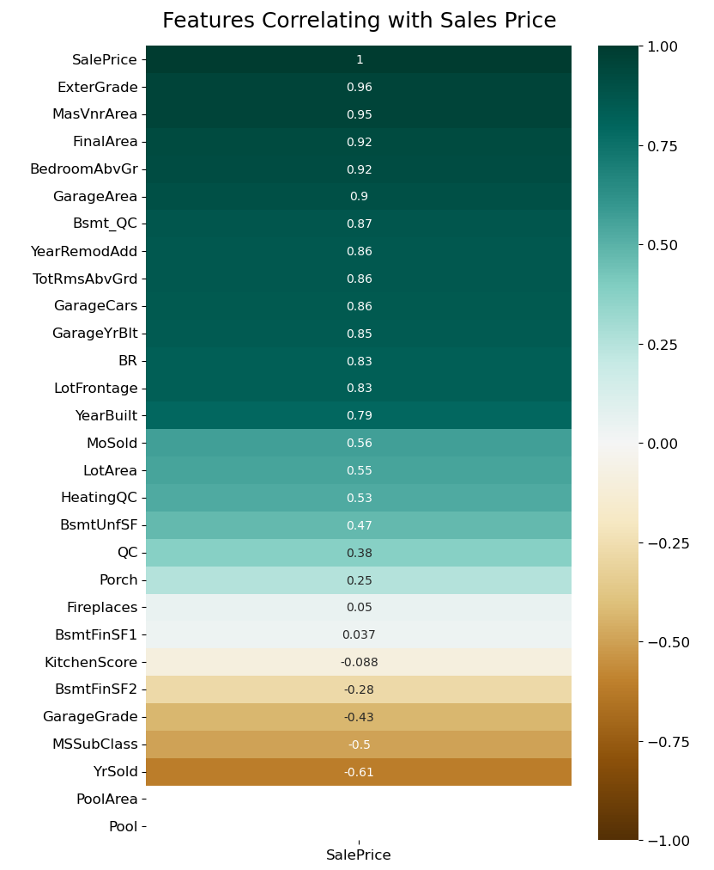
Feature correlation plot
02 | eda
Plot
Description
The correlation plot helps us understand which variables are potentially valuable to include in a predictive model
Variables with strong both positive and negative correlations are most likely to inform our model
For instance, “ExterGrade” and “MSSubClass” could be strong predictors
Fireplaces, on the other hand, appears to not be related to price and therefore won’t inform our model

Slide 13
03
Data preparation

Slide 14
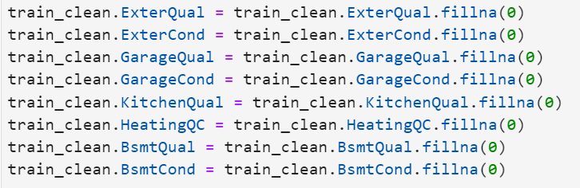
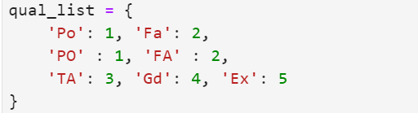
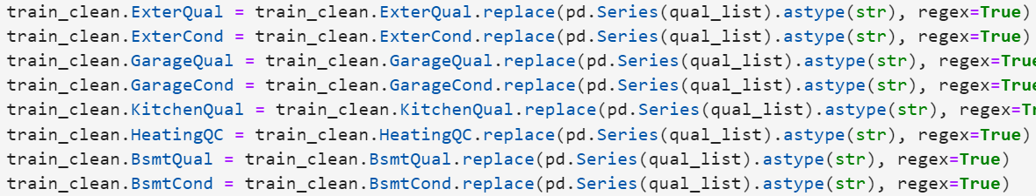
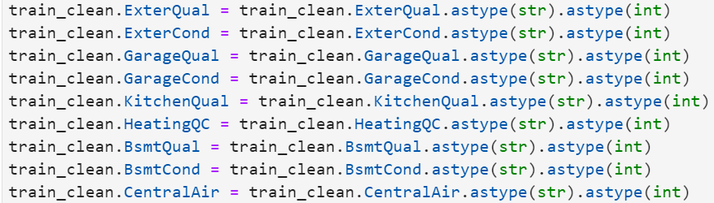
Replace nan with 0 to indicate missing
03 | data preparation
Description
Python Code
Identify ‘nan’ or missing values within data and replace with “0” to indicate that the missing data represents nonexistence
Convert categorical columns into numeric input for regression modeling
Convert numerical data categories from string to integer to prepare for modeling

Slide 15
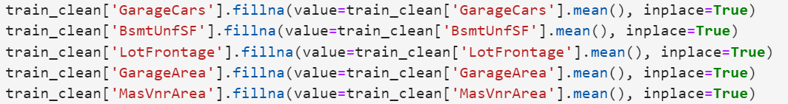
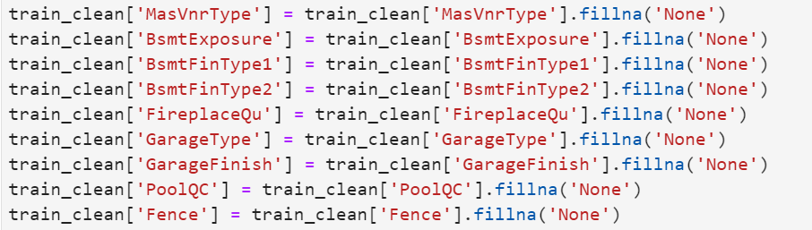
Replace 0 and Nan by mean or “None”
03 | data preparation
For variables representing qualities or a continuous variable, replace the “0” or “nan” with the mean value
For variables representing type or existence of a feature, replace the “0” or “nan” with “None”

Slide 16
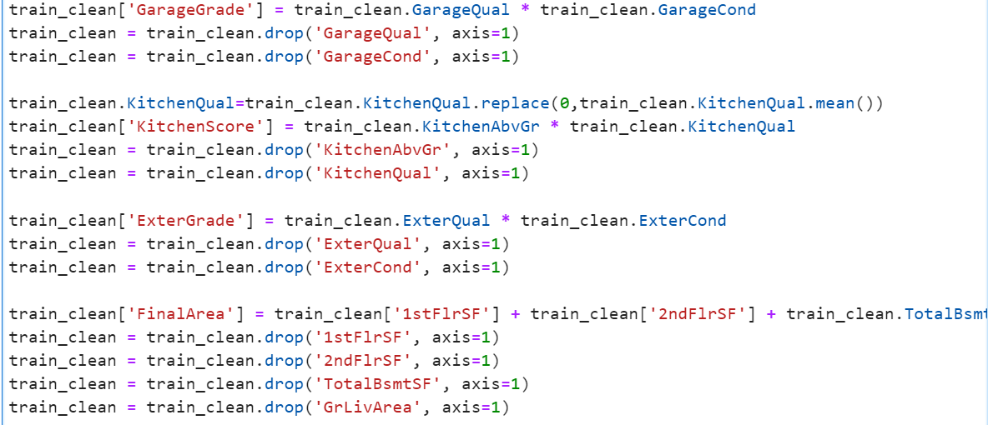
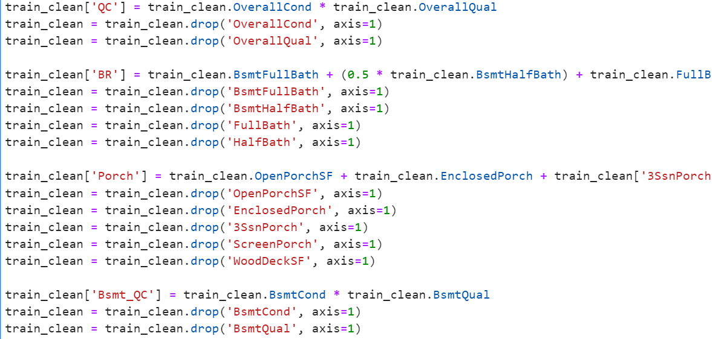
Consolidate variables into new columns
03 | data preparation
Garage Grade Feature
Kitchen Quality
1
5
External Grade
Final Square Footage Area
2
6
Overall Quality Condition
Porchs
3
7
Bathrooms
Basement Quality
4
8

Slide 17
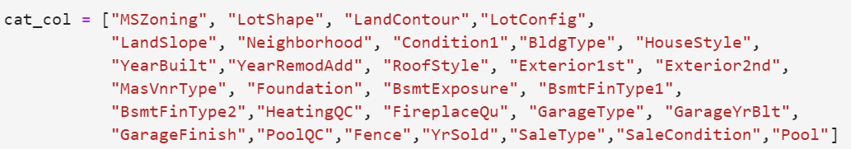
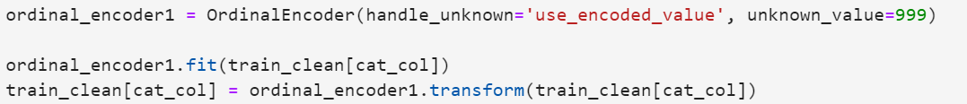
Ordinal encoder for categorical values
03 | data preparation
Utilize Ordinal Encoder for Categorical Values to Convert into Numerical Feature
Description
Categorical Feature Identification
Determine all categorical columns which require conversion into a numerical feature for each unique category in order to utilize regression modeling capabilities
Train the ordinal encoder for each categorical feature within the training data and apply to both train and test data sets
If a new category appears in the test data, replace with 999
Ordinal Encoder Fit & Application

Slide 18
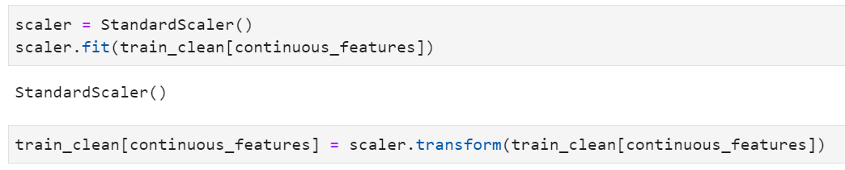
Scaler for continuous features
03 | data preparation
Utilize Scaler for Continuous Values to Avoid Incorrect Comparisons Between Large & Small Values
Description
Continuous Feature Identification
Determine all continues columns which require conversion into a scaled feature to avoid columns being incorrectly compared against one another for large and small values
Train the scaler for each continuous feature within the training data and apply to both train and test data sets
Scaler Fit & Transform for Continuous Variables

Slide 19
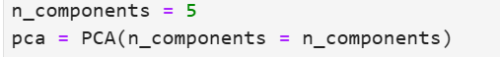
Prepare x/y features in PCA
03 | data preparation
Fit & Transform PCA in Train Data
Description
Fit PCA On Continuous Features
Determine 5 components to use in PCA and fit PCA on continuous features (column 1:22) and transform
Prepare final train data frame via concatenating PCA with sales price (column 0) and categorical features(column 23:)
Define X and Y Features For Tree
Define sales price as dependent variable and other features as independent variables for tree models.

Slide 20
Prepare x/y features in PCA
03 | data preparation
Fit & Transform PCA in Validation Data
Description
Fit PCA On Continuous Features
Fit PCA on continuous features (column 1:22) and transform
Prepare final validation data frame via concatenating PCA with sales price (column 0) and categorical features(column 23:)
Define X and Y Features in Validation For Test
Define sales price as dependent variable and other features as independent variables in Validation

Slide 21
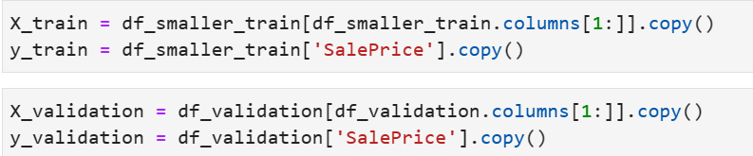
Prepare x/y features W/O PCA
03 | data preparation
Fit & Transform PCA in Validation Data
Description
Define formula with independent and dependent variables
Define sale price as Y and other features as X in train data and validation data
Define formula with sales price as dependent and other features as independent variables, removing intercept
Cleaning special characters in column names
Replace leading Q and special characters in column name

Slide 22
04
modeling

Slide 23

Modeling approach
04 | modeling
Cross-Validation
Individual Performance
Ensemble Performance
Evaluation Metric
Performed cross-validation utilizing a 75/25 train/ test split
Training data separated into smaller train and validate for purposes of training individual models
Individual model performance based on five model types:
Random forest
Decision tree
Neural network
XGBoost
Light GBM
Feature importance per model assessed to determine optimal features
Optimal models weighted based on linear regression
Weights utilized to determine final ensemble model for Kaggle competition
Mean Squared Log Error utilized as primary evaluation metric for Kaggle competition
R^2, mean absolute error (MAE) and root mean squared error (RMSE) additionally included for enhanced evaluation to assess whether model overfit

Slide 24
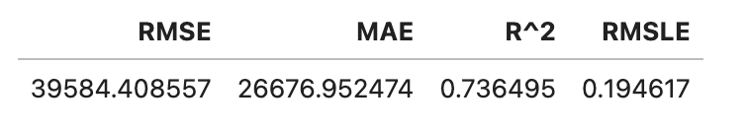

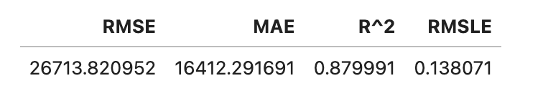

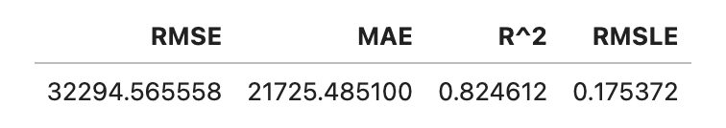
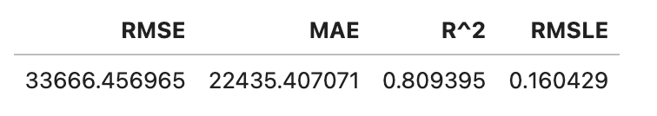
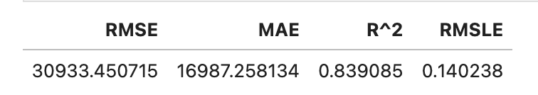
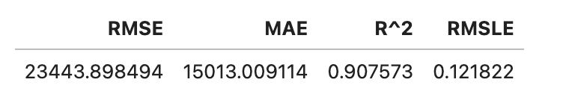
Individual MODEL PERFORMANCES
04 | MODELING
Random Forest with PCA
Random Forest without PCA
Decision Tree
Neural Network without PCA
XGBoost without PCA
LightGBM without PCA

Slide 25
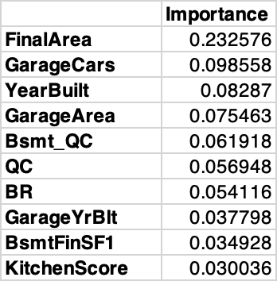
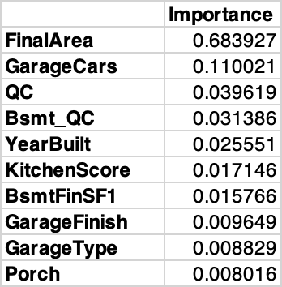
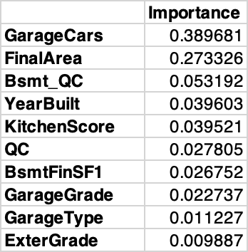
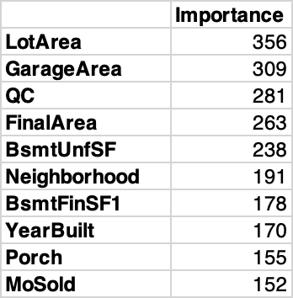
Feature Importance
04 | modeling
Random Forest without PCA
Decision Tree
XGBoost without PCA
LightGBM without PCA
Neural Network without PCA
Feature importance will not provide any insight for a Neural Network.

Slide 26
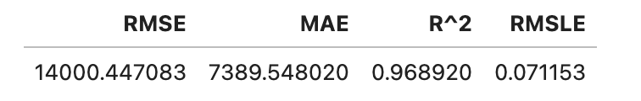
Ensemble MODEL PERFORMANCE
04 | modeling
Random Forest without PCA
Decision Tree
Neural Network without PCA
OLS Ensemble
XGBoost without PCA
LightGBM without PCA

Slide 27
05
Findings

Slide 28

Test PERFORMANCE
05 | findings
Feature Importance Within Model
Description
The OLS Ensemble is a powerful tool to test the performance of a housing pricing model
The r2 score indicates that the model is able to capture 96.8% of the variability in housing prices
The RMSLE score indicates that the model is able to produce results with an accuracy of 7.11%
Both scores are very good, suggesting that the model can accurately predict housing prices
Final model performance in Kaggle on test data achieved an RMSLE of 0.28287

Slide 29
05 | findings
Modeling findings for zillow
Our team concluded the experiment with a predicted model performing at 96.8% control over the response variable due to a change in input variables and an RMSLE of 0.28287 with the test data in Kaggle
The advanced regression techniques utilized, including XGBoost, random forest, and decision tree, resulted in significant reduction in RMSE
Despite a performance of 0.28287 with the test data, there continues to be scope for improving the model:
Enhance selection of variables with data subset
Expand training data to larger sample size
Further consolidate similar data features

Slide 30
Strengths and weakness of ensemble
05 | findings
Strengths
Weakness
Highly flexible given the ensemble approach
Explains significant amount of the variance in the data, as well as its accuracy in predicating housing prices
Able to reduce the amount of bias as compared to using a single model type
Effective at prediction with the non-linear data available
Utilizes both categorical and numerical features to enhance prediction
Limited to those categorical variables included in the encoding process, so is less effective at capturing new categories that may appear in future test data
Specific to the Ames housing market, requiring retraining as the model is expanded into different markets
Model parameters chosen may not be optimal, leading to suboptimal results in the test

Slide 31
06
conclusion

Slide 32
Conclusion & Zillow results
06 | conclusion
Type of house (single-family vs. multi-family) and number of bedrooms are significant features to predict future house prices
The model was able to identify important features that affect housing prices, such as house type, number of bedrooms, overall quality, total living area, and neighborhood
The findings from this model can provide a better understanding of the various elements that affect the sale price of a home
This can be useful for Zillow in reinvigorating the home buying program you make decisions on our offer to home buyers
Extrapolate model to regions outside of Ames, Iowa to determine house price sales and reinvigorate home purchase program

Slide 33

Thank You.

